Slide 1
SOFTWARE ENGINEERING & PROJECT MANAGEMENT

Slide 2
Team members
SIDDHAM SINGH -RA2011027020105
PHANINDRA VARMA -RA2011027020117
ARYAN MORE -RA2011027020113

Slide 3
Objective
This system aims at improving the efficiency in the issue of the Passport, reduces the complexities involved in it and for the effective dispatch of the passport to the maximum possible extent.

Slide 4
Problem Statement
TEDIOUS PROCESS: Requires a large number of skilled individuals in various fields of issuing Passport. Chances of error and workload on each individuals is more.
TIME CONSUMPTION: Takes a lot of time when it is done manually. Search for particular data also leads to unnecessary delays.
DATABASE MANAGEMENT: Due to the increasing number of applicants, the management and the processing of data are difficult to update and maintain with time.
SECURITY: More accessibility to data, which made tampering much easier.

Slide 5
Existing System
Existing system is to use human labor and to rely on the human intellect, which is prone to errors. If the entire process of 'Issue of Passport' is done in a manual manner then it would takes several months for the passport to reach the applicant The above problem can be overcome by using Passport Automation System. Instead of using manual process, we can automate this process of issuing Passport which increases the efficiency and reduces the complexities.

Slide 6
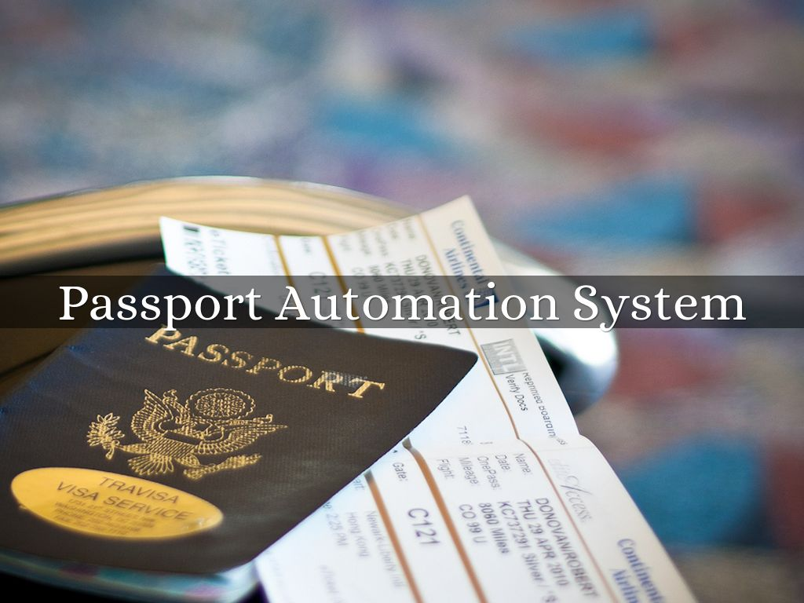
Proposed System
The above problem can be overcome by using Passport Automation System. Instead of using manual process, we can automate this process of issuing Passport which increases the efficiency and reduces the complexities. .

Slide 7
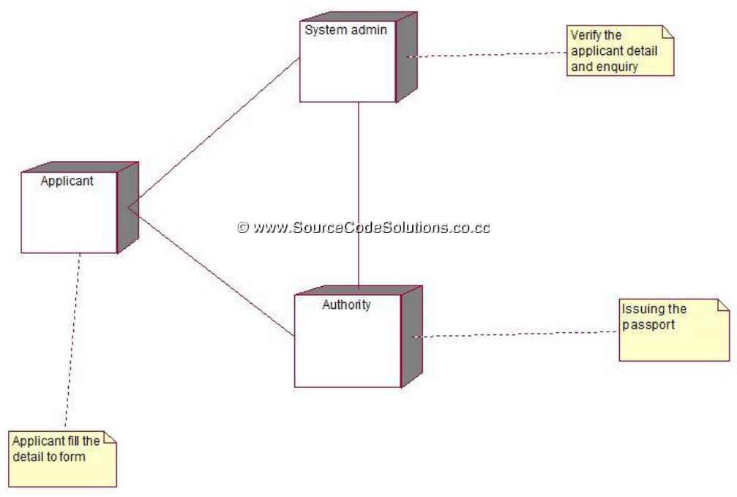
Architecture Diagram

Slide 8
Module Description
Module 1:
1st module contains the front end and back end design for the login or signup page.
Module 2:
2nd Module is termed as Detail Type where they will be asked to provide necessary information to access the next segment of the program.
On access the software will process the details to provide an passport for the following user.
Module 3:
In 3rd module the user can update any information in the given passport. If the details given in module 2 is present in database,
Else they can apply for an completely new passport and will ne directed to registration page.
At registration page they an register themselves and can apply for an new passport.

Slide 9
UML
The Unified Modeling Language is a general-purpose, developmental, modeling language in the field of software engineering that is intended to provide a standard way to visualize the design of a system.
UMLs used:
Use Case, Data Flow Diagram, Class Diagram, Collaboration Diagram, State Chart Diagram and Sequence Diagram
Unified Modelling Diagram(UML)

Slide 10
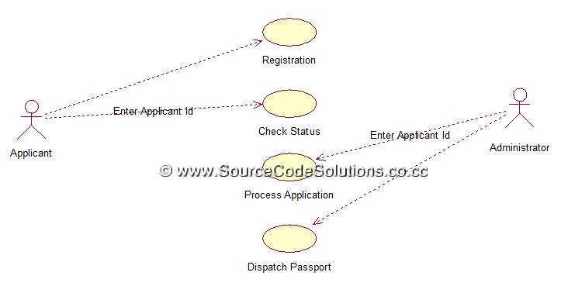
Use Case Diagram

Slide 11
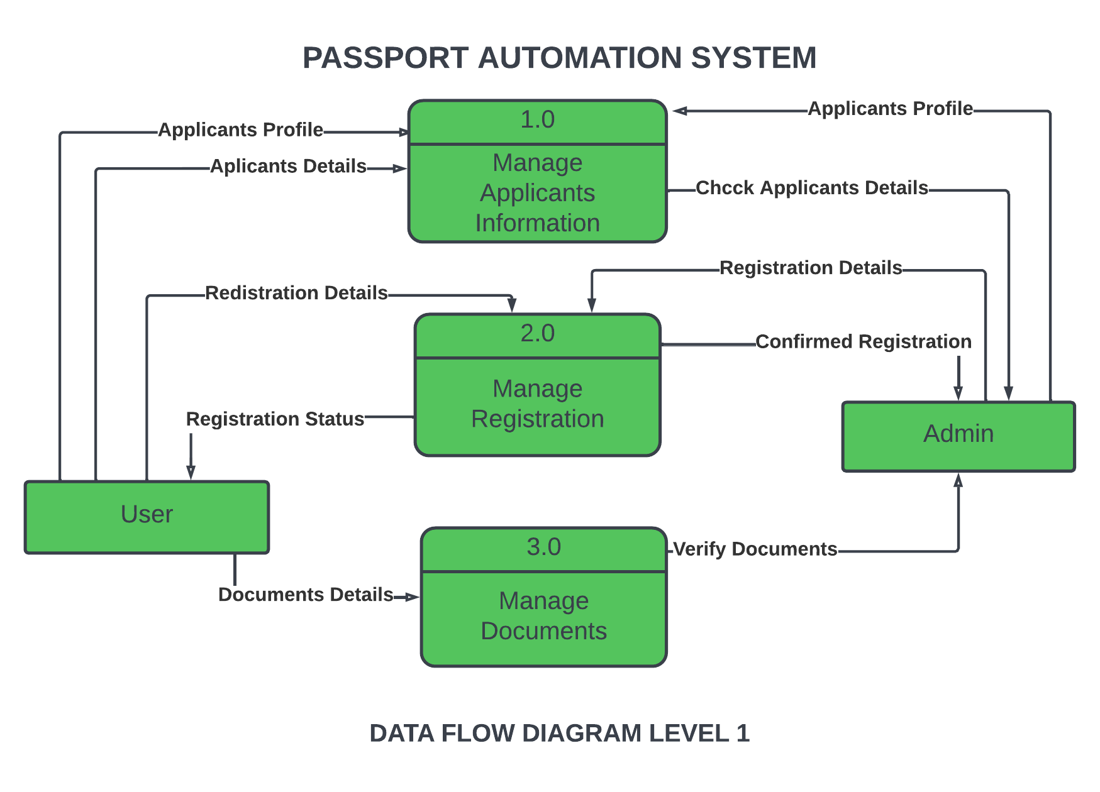
Data Flow Diagram

Slide 12
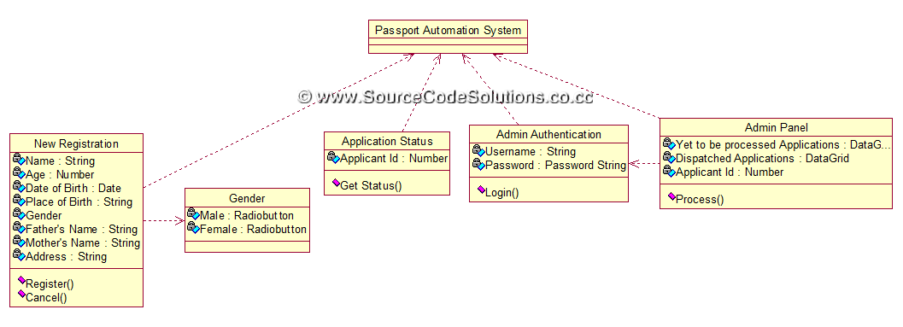
Class Diagram

Slide 13
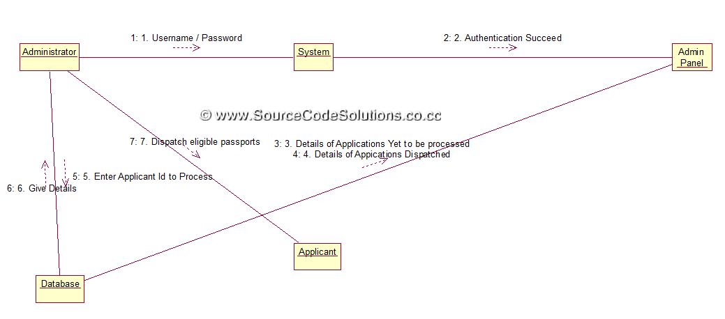
Collaboration Diagram

Slide 14
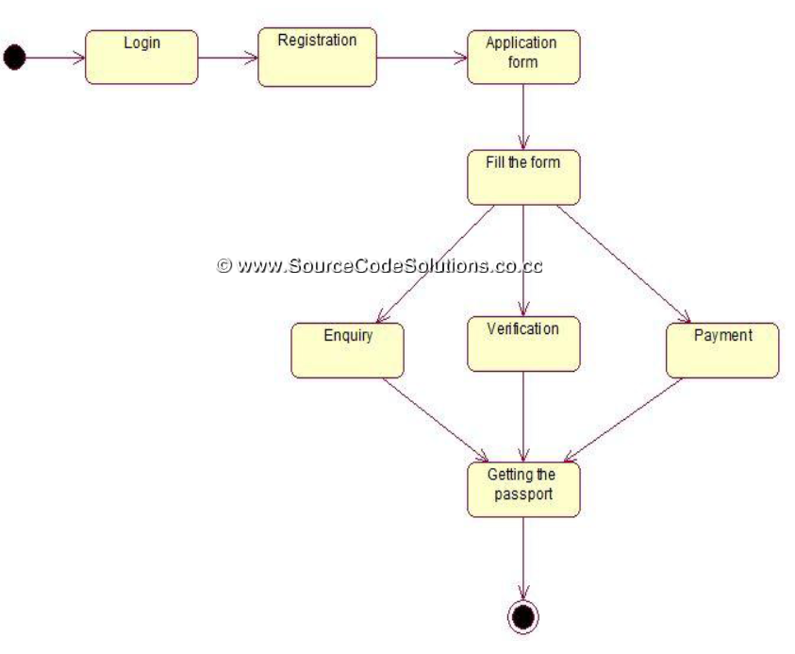
State Chart Diagram

Slide 15
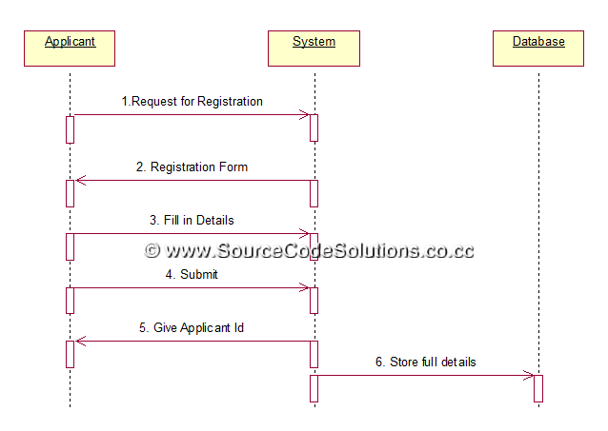
Sequence Diagram

Slide 16
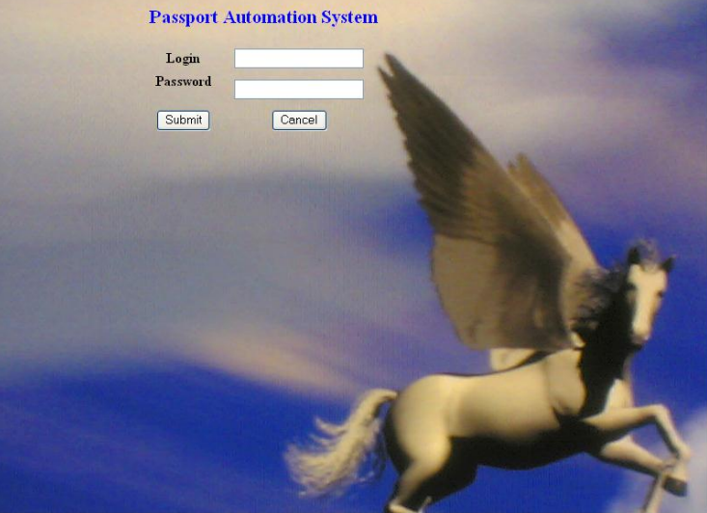
DEMO

Slide 17
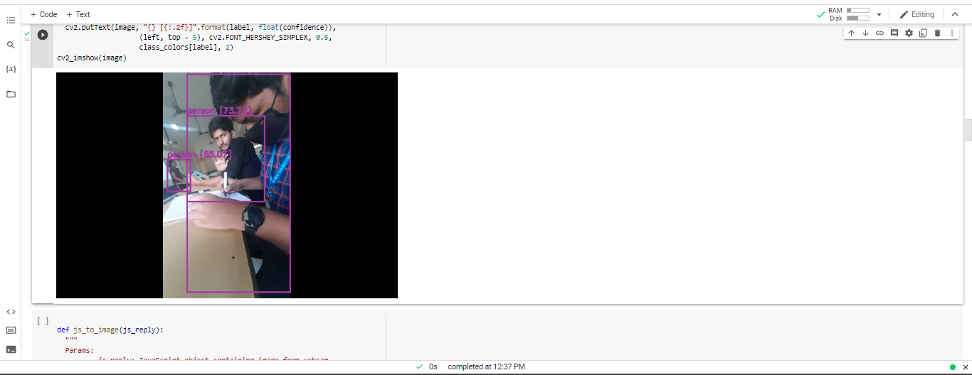
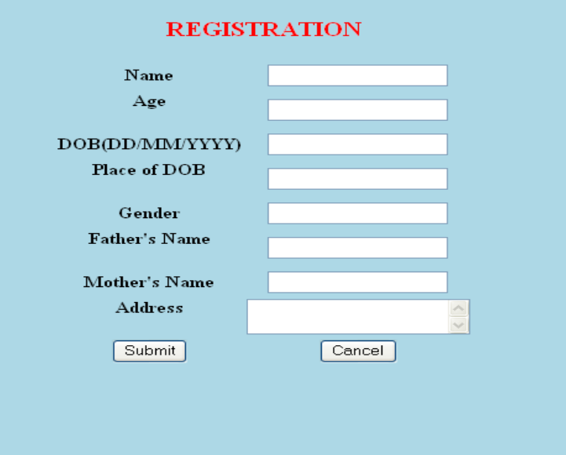
Demo

Slide 18
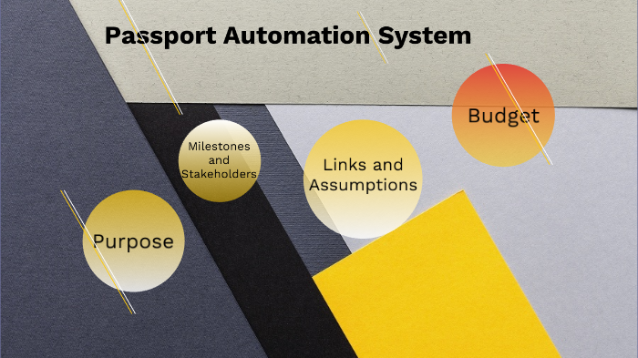
conclusion
The entire project has been developed and deployed as per the requirements stated by the user. It is found to be bug free as per the testing standards that are implemented
The performed the modelling of the collected data and processes, transforming it into UML diagrams with the aid of a UML modelling tool.
Structured analysis uses DFDs (Data Flow Diagrams) to model data and processes, systems analysts use UML to describe Object Oriented systems, on which the current system is based.
UML is independent of any specific programming language and can be used to describe business processes and requirements generally.
Finally, the implementation or coding of the proposed system was based on the software architecture standard, PHP using python programming language, HTML and JS which is based on the object-oriented paradigm

Slide 19
references
Google.com
Wikipedia.com
Youtube.com

Slide 20
THANK you
Any Question ?

